Slide 1
Rivers and Harbors Act of 1899 Section 10: Navigable Waters
Through the lens of the 1995 film: Waterworld.
If you haven’t seen it... you have homework... And this presentation will leave you more confused than anything...

Slide 2
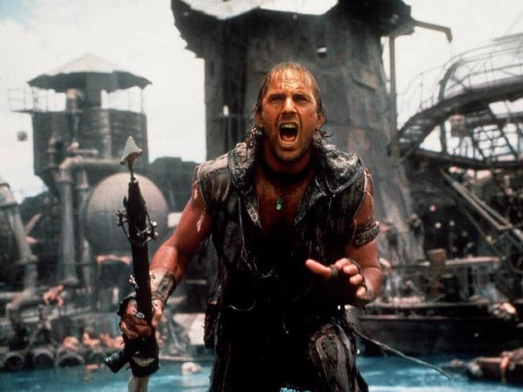
Authority
Authorizes the United States Army Corps of Engineers (aka Kevin Costner)
to issue permits for structures
or work in or affecting the
navigable waters of the
United States.
USACE:
Notes:
Let’s say USACE is Kevin Costner... A bad ass amphibious sea goer that fights bandit pirates while going about his own business of survival. In this case, his business is to protect the navigable waters of the US.

Slide 3
Navigable Waters of the U.S.
A hot momma and her prophetic child that has a map to dry land tattooed on her back.
Actually...
Waters subject to tidal ebb and flow, and/or
Those waters that are presently used, or have been used in the past, or may be susceptible for use to transport interstate or foreign commerce
Notes:
Section 10 of the rivers and harbors act of 1899 requires that regulated activities conducted below the ordinary high water elevation of navigable waters of the US be approved/permitted by the USACE.
In other words. Kevin costner is the protector and anything that happens to this mom and daughter is under his responsibility. Interestingly enough, his attitude to these two is fairly aggressive and sees them as a burden. He learns to love them though... But that’s hollywood...

Slide 4
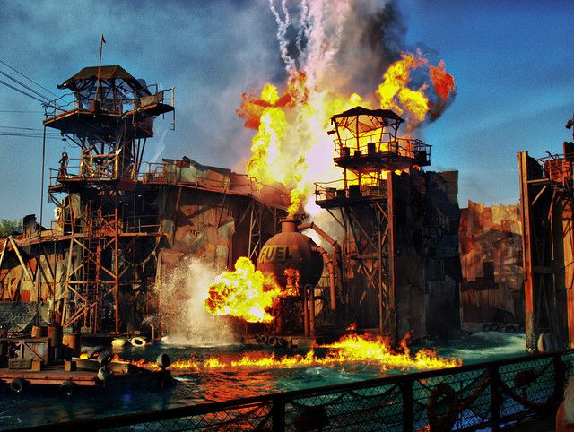
Commerce on Navigable Waters
What could go wrong?
Notes:
Let’s just say things could go south rather rapidly...

Slide 5
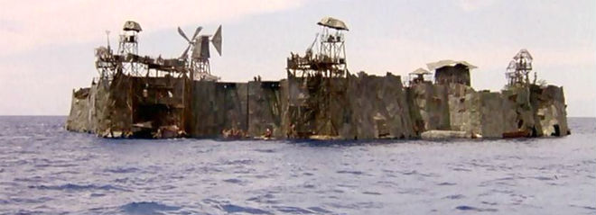
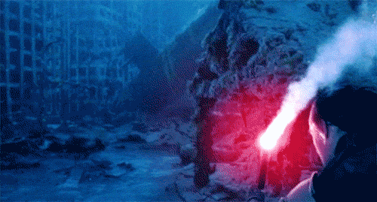
Regulated (Jurisdictional) Activities
Examples:
Structures and/or work
Dredging/Fill
Excavation
Notes:
Any work affecting the course, condition, location, or capacity of the navigable waterbody.

Slide 6
The Permit Process
It’s really not all that bad...

Slide 7
Types of Permits
USACE uses three types of general permits:
Nationwide
Regional
& Programmatic
Because we live in Bureaucracyworld...
Notes:
USACE's Regulatory program is implemented by 38 district offices and not all districts use all types of general permits. In addition, many districts have regional conditions on Nationwide Permits so when determining if the project meets the terms and conditions of a Nationwide Permit, first verify which district the project is in and then visit the district website for the regional conditions. District offices can also answer any questions regarding the terms and conditions and/or applicability of a certain general permit to a proposed activity.

Slide 8
Process Flow Charts
The map to dry land...
Notes:
The flowchart assumes that the developer already knows a permit is required. In cases where the developer is unsure if an aquatic feature, such as a wetland, at the potential project site is jurisdictional and subject to Section 10 permit requirements, he or she should contact USACE district early in the process, prior to the project design stage if possible, to discuss any information that may be needed by USACE to make a jurisdictional determination, such as a wetland delineation report. To avoid delays during the application review process, such information should be provided to USACE as early as practicable.

Slide 9
Boring slide #1
Notes:
FERC – Federal Energy Regulatory Commission

Slide 10
Boring slide #2
Notes:
Fun cycle to get stuck in

Slide 11
Boring slide #3
Notes:
Within 15 day or receipt of a complete application, the USACE district office will issue a public notice of the submitted application.
Whenever a public hearing is needed for USACE to make a permit decision or upon request by any person, in writing, during the comment period, a public hearing will be held on the proposed permit decision. USACE will only hold one if it determines such a hearing is necessary to make an informed decision.

Slide 12
Boring slide #4
Notes:
CZMA – coastal zone management act

Slide 13
Boring slide #5

Slide 14
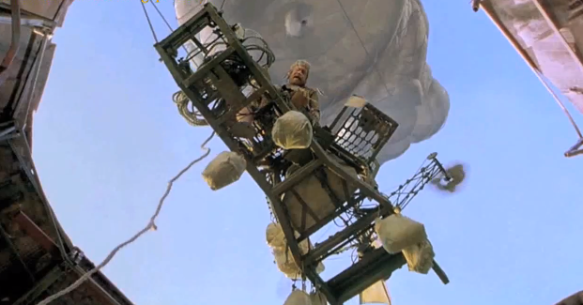
And we’re off
Sorry... no time for questions

